Slide 1
XMCD analysis
I09 data, april 2016
Jonathan Beekman

Slide 2
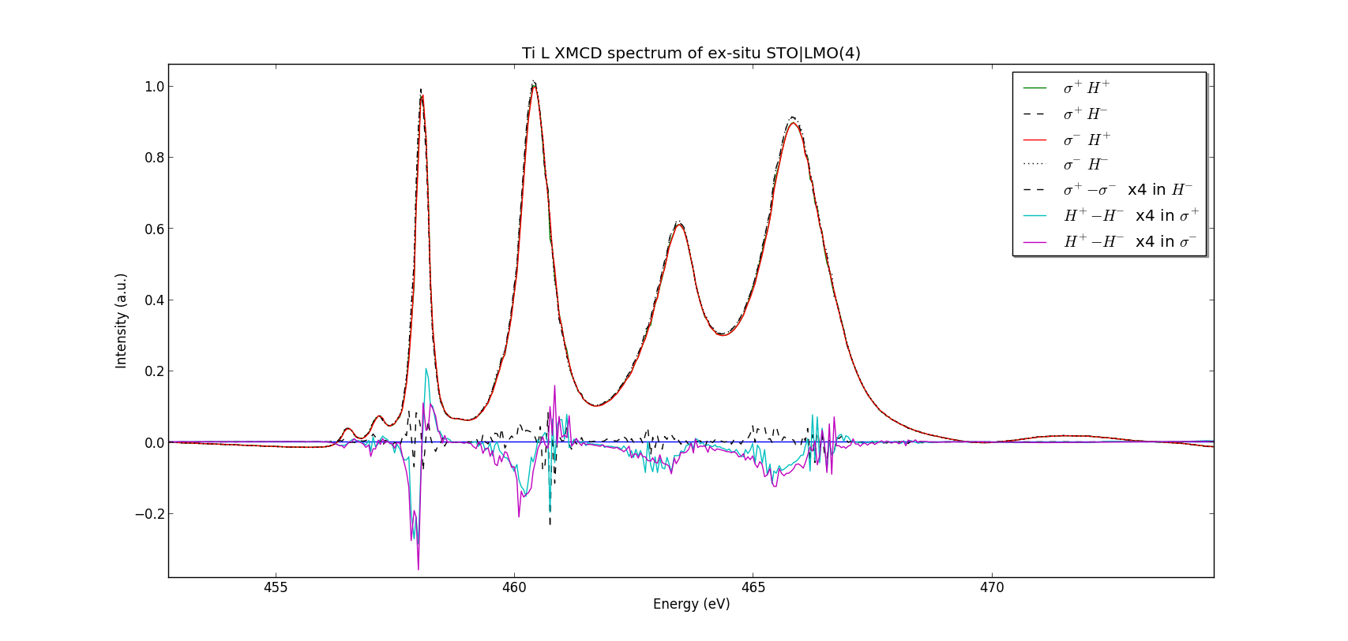
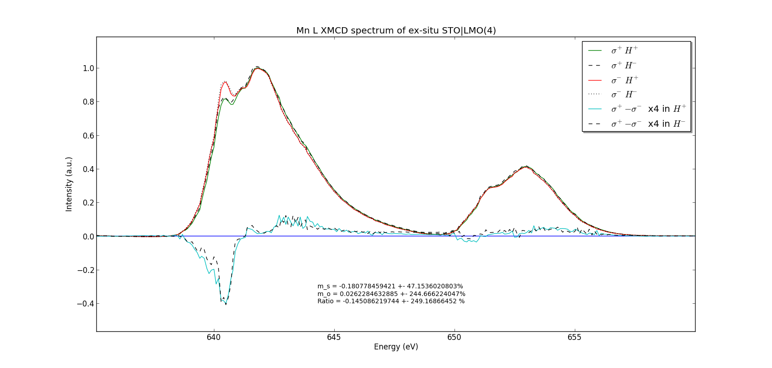
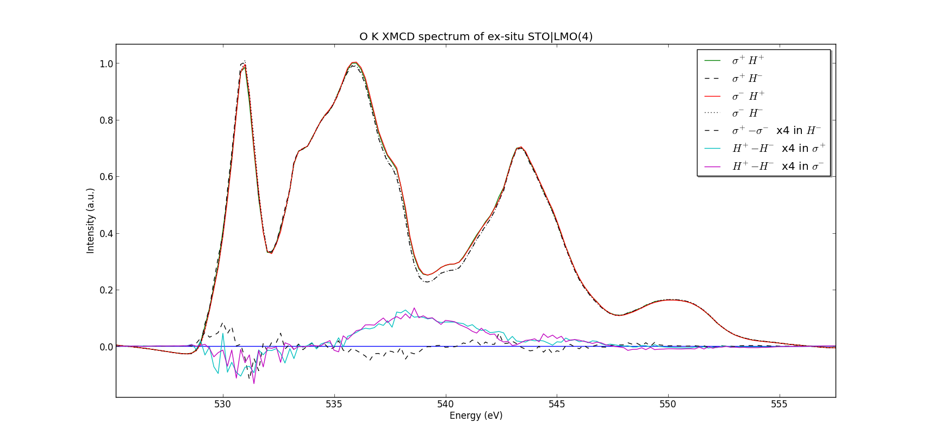
Ti L
Ti L
STO|LMO (4uc)
All ex-situ samples
(Transported in-situ and moved to
new sampleplate ex-situ before XMCD)
Oxygen K
Mn L
Oxygen K
Mn L

Slide 3
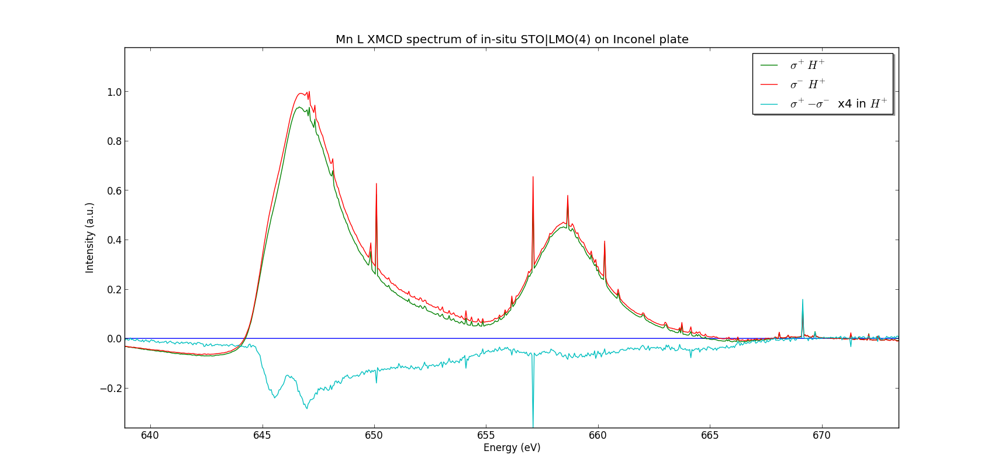
In situ sample
On (magnetic?) Inconel plate
STO|LMO (4uc)
Mn L-transitions
Ex situ sample

Slide 4
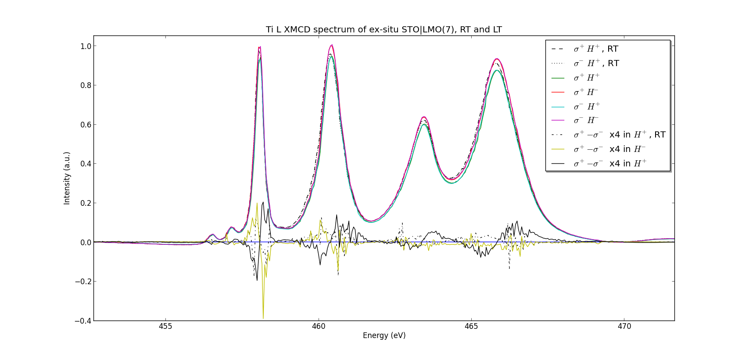
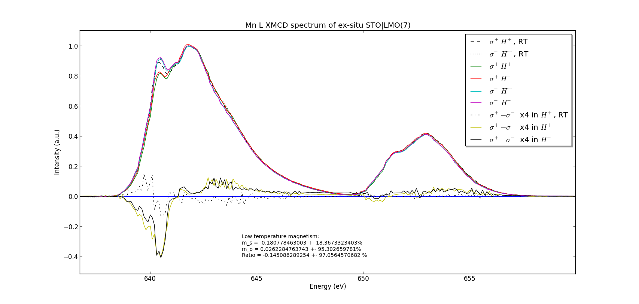
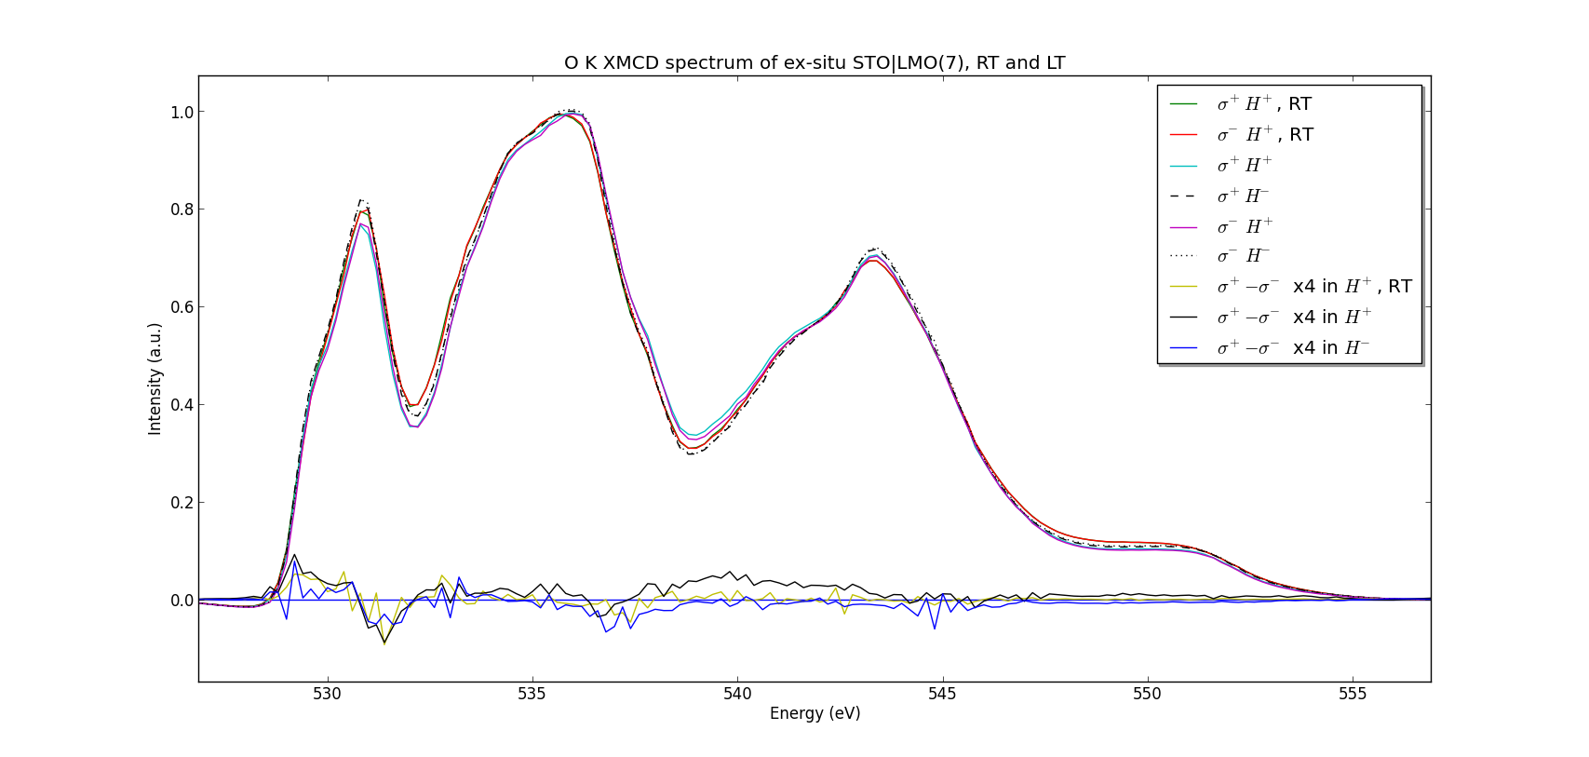
Ti L
STO|LMO (7uc)
All ex-situ samples
(Transported in-situ and moved to
new sampleplate ex-situ before XMCD)
Mn L
Oxygen K

Slide 5
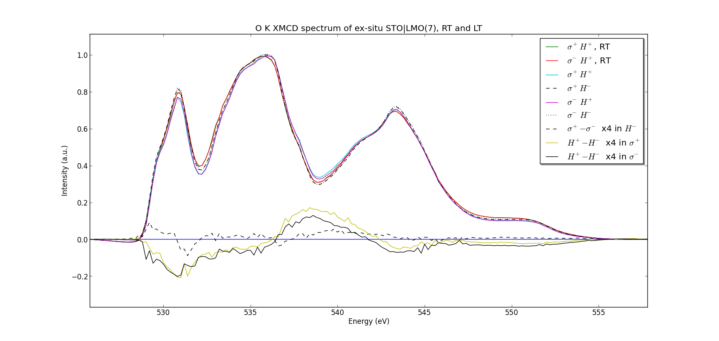
STO|LMO (7uc)
O K measurements
XMCD signal
Substraction of left circular polarised from
right circular polarised spectrum
Magnetic field induced signal
for constant polarisation

Slide 6
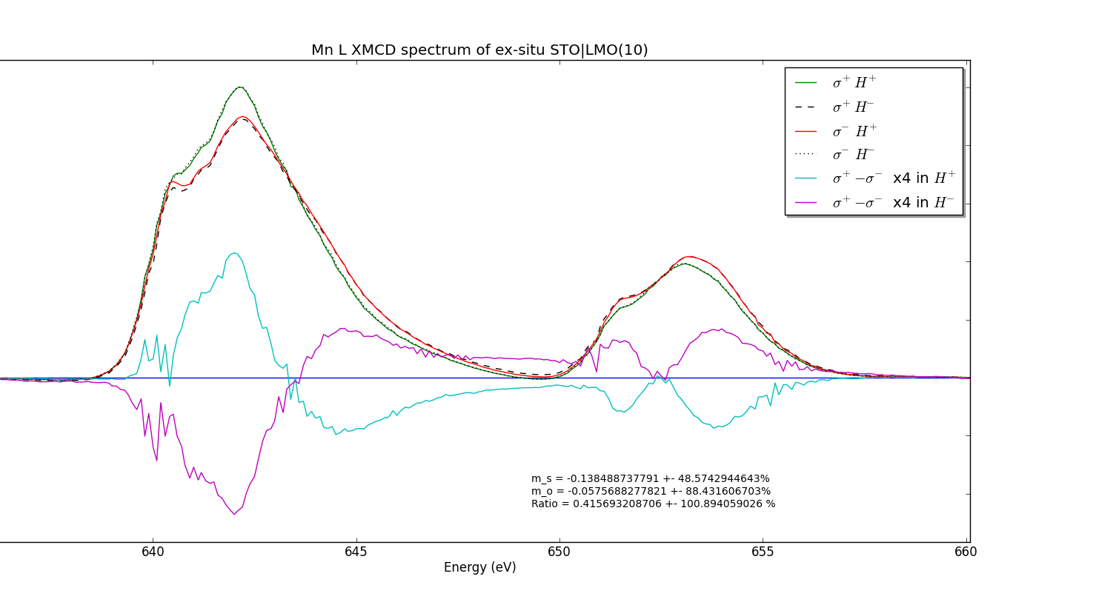
4 uc
Mn L edge
7 uc
10 uc

Slide 7
4 uc
Ti L edge
XMCD signal
Magnetic-field induced signal
7 uc

Slide 8
O K measurements
O K edge
4 uc
Magnetic field induced signal
Substraction of up- from down directed
magnetic field spectrum
XMCD signal
Substraction of left circular polarised from
right circular polarised spectrum
7 uc

